Slide 1
Agenda
Time | Session | Details
08:30 - 09:00 | Settle in
09:00 - 09:30 | Introduction – Insight into Ameriprise goals for modernization | Understanding Ameriprise’s pain points and modernization goals. Ameriprise team to present.
09:30 - 10:15 | Executive perspective – Role of IBM Z in Hybrid cloud. | Covers approach to enterprise modernization and enabling mainframe in a hybrid cloud environment.
10:15 – 11:00 | Mainframe Update | Session Latest happenings on IBM Z (mainframe)
11:00 – 11:15 | Break
11:15 – 12:30 | End to end DevOps Journey for mainframe | Discuss details on approach to end to end Devops, current state, proposed architecture and next steps. This will also cover a deep dive on GIT Migration from legacy SCMs.
12:30 – 1:00 | Lunch
1:00 – 1:45 | Data Modernization with Analytics on Z | Introduction to IBM z Open Data Analytics, use cases for Analytics on the mainframe and benefits of doing this.
1:45 – 2:30 | Service Discovery & API Enablement | Infosys approach to identifying services from existing applications, API enable them and relating that to stands in do gap analysis.
2:30 – 3:00 | Wrap up & Next Steps

Slide 2
DevOps on Z
Hannah Neumann
Nelson Lopez

Slide 3
Overview
(Concepts –Git/DBB
The big Idea
Devops for distributed has benfitied from modern tools and practices like Git, Git Hub, Automated build with
Benefits
How it fits the long term Devops journey
Financial saving
Git is free
DBB cost?
Case Study
Customer expericens
Who has adopted - client list?

Slide 4
Fun Facts
DBB first release start of 2018
Current release 1.0.5 GA June 2019
Rocket Git GA Feb 2017
XXX users have migrated or are migrating to DBB/Git DevOps
Git is free… and a strategic business partner with IBM to provide support and upgrades … fee?
The big Idea – DBB enables an automated build workflow by finding and compiling all dependent source files related to a change to a related component. For example, if you change a cobol copybook, all the related programs and sub-programs that are re-compiled.
Git provides all the value of a standard distribute SCM for mainframe source files, COBOL and more to come..

Slide 5
Disclaimer
IBM’s statements regarding its plans, directions, and intent are subject to change or withdrawal without notice and at IBM’s sole discretion.
Information regarding potential future products is intended to outline our general product direction and it should not be relied on in making a purchasing decision.
The information mentioned regarding potential future products is not a commitment, promise, or legal obligation to deliver any material, code or functionality. Information about potential future products may not be incorporated into any contract.
The development, release, and timing of any future features or functionality described for our products remains at our sole discretion.
Performance is based on measurements and projections using standard IBM benchmarks in a controlled environment. The actual throughput or performance that any user will experience will vary depending upon many factors, including considerations such as the amount of multiprogramming in the user’s job stream, the I/O configuration, the storage configuration, and the workload processed. Therefore, no assurance can be given that an individual user will achieve results similar to those stated here

Slide 6
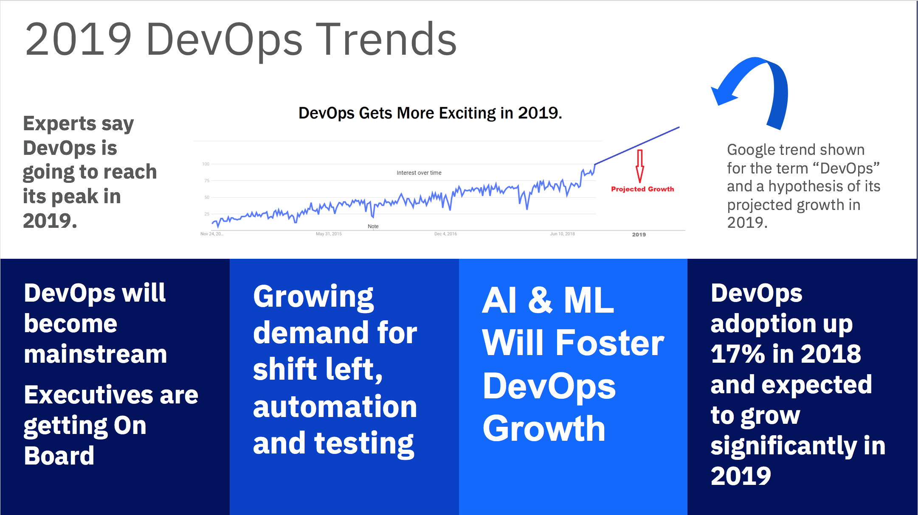
DevOps is no longer a buzz word
Notes:
DevOps is no longer a buzz word. Statistics shows that DevOps is expected to grow much higher than the previous years in 2019. You all are testimonial to the fact that it is growing. I am sure all of you in the room are having conversations around DevOps with your customers and you see that the conversations are more year on year.

Slide 7

Open Source
92% of developers agree that open source tools are critical to software innovation
84% of developers prefer to use open source over closed or proprietary tools

Slide 8
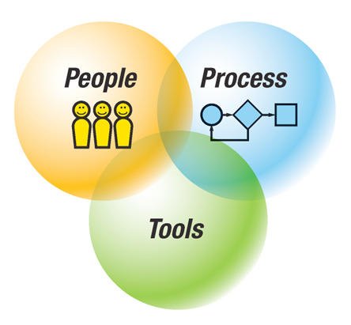






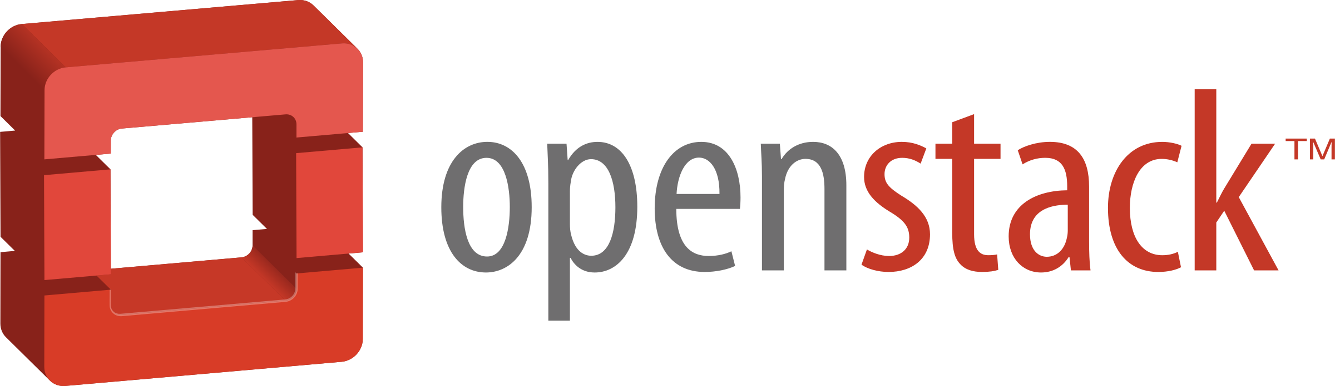
Z DevOps → The Technical Value Proposition is Strong
ENTERPRISE WIDE STANDARDIZATION
AUTOMATION
Powerful and automated unit testing as part of a continuous delivery pipeline
50-90% time savings on test cycles²
Platform neutral, continuous integration and deployment pipeline across the enterprise. Uniform enterprise wide agile delivery processes and standards facilitates transferable skills
DevOps
Tools
MODERN DEVELOPMENT PRACTICES
SKILLS AVAILABILITY
Advanced Application Intelligence, Modern development IDEs to empower the next generation of developers.
20-50% productivity benefits for typical development tasks¹
#2 on Glassdoor’s 50 best Jobs in America Rankings and one of the Top 5 Technical Skills Growth areas
Successful DevOps transformation results in 7x lower software delivery change failure rate³
Strong Integration with Open Source → 84% of developers prefer to use open source over closed or proprietary tools⁴
OPEN TOOL CHAIN
Notes:
1.Source – Validated customer feedback
2. Source - https://dzone.com/articles/the-roi-of-automated-testing
3.Accelerate State of DevOps Report 2018
4. GitLab 2018 Global Developer Report. (n.d.). Retrieved from https://about.gitlab.com/developer-survey/2018/
5. https://www.ibm.com/account/reg/us-en/signup?formid=urx-17749
6. https://www-01.ibm.com/common/ssi/cgi-bin/ssialias?htmlfid=65014265USEN&
Combining Agile and DevOps practices can make it easier to build open and hybrid applications. DevOps is the union of People, Process, and Tools to enable continuous integration and continuous delivery to our clients
People – we need to ensure that everybody delivering value to the business is working tightly together on the common goal of adding value for the customer.
Process- DevOps is about improving processes because even if you have highly motivated people that are working well together, you may still have several business processes which may get in the way, and this could really block innovation.
Tools – There are products, tools, and services that can help enable different DevOps practices and different teams which can be used to make things easier.
But even with the best tools, DevOps is just another buzzword if you don’t have the right culture.
The primary characteristic of DevOps culture is increased collaboration between the roles of development and operations. There are some important cultural shifts, within teams and at an organizational level, that support this collaboration
It IS possible and you CAN transform your zOS environment to a true, modern DevOps practice. There is nothing about Z that stops you from doing DevOps. We can bridge the gap between mainframe and distributed by bringing modern SCMs, modern parallel development and by letting developers work in mainframe and distributed worlds in the same way.
IBM’s end to end cross-platform delivery pipeline solution integrates with a variety of open source and third party tools allowing you to balance between open source and enterprise tooling to choose a pipeline that is right for your organization based on business needs.
Some of the open source and third party integrations that we offer are listed at the bottom of the slide – including GIT, Jira, Jenkins, SonarQube to name a few.
We want to focus on a common tooling across the development process. And outside of mainframe development, Git has become the defacto standard for source control in application development.
IBM Z Open Development is an ecosystem of capabilities that enables developers to get the most out of a modern SCM like Git and standardizing on true parallel development across the enterprise. ZOD helps you to work with mainframe application source that is stored in Git. It also include Dependency Based Build – which allows you to have a build took kit which you can use to build your applications and analyze the dependences required for build. DBB also includes Groovy for automation so it actually helps you to bring your mainframe processes into the world of open source so you can hook up your mainframe processes to CI/DC to open source tools like Jenkins. In a nutshell, ZOD is a full set of capabilities that allow you to accelerate devops.
Other common tooling to embrace DevOps include Jenkins to manage CI and CD workflows and this can be the same Jenkins master that is running your distributed workloads.
There is UrbanCode for deployment – again this can be the same Urban code that is used to deploy your distributed code into cloud environments and on prem environments
When we talk about deploying more changes faster, we need true parallel development that empowers the developer with autonomy for development and testing.
Automation
Continuous testing is a key part of DevOps and it means testing earlier in the life cycle, which results in reduced costs, shortened testing cycles, and continuous feedback on quality. This process of shift-left testing, stresses integrating development and testing activities to ensure quality is built-in as early in the life cycle as possible.
It’s important that the first step of the testing is done in a clean and automated way so you’re feeding in tested code into the rest of the lifecycle. And that’s why we’re investing in Unit Testing. Z Open Unit Test will be an advanced and flexible tool for writing and executing automated unit tests of programs on IBM Z.
Using ADDI, you can identify most essential test cases, redundant test cases and understand code coverage. So you use ADDI to determine what data sets need to be provisioned and can then use
(zD&T) for rapid provisioning. With zD&T, you have the ability to rapidly spin up and take down z/OS test environments on demand both on premise and in the cloud. It empowers development teams with autonomy to have their own test environment… which means you avoid issues of contending for resources or even contenting for capacity.
So When you combine the automated unit testing capabilities of Z Open Unit Test, application understanding capabilities of ADDI to facilitate targeted provisioning with zD&T, it becomes a game changer and can truly differentiate you when you’re striving for more agility with testing on the mainframe.
Another driving factor for common tools across the stack is that we need to attract the younger generations to this environment, we need to bring the current development practices to this environment. And we can do that by looking at the distributed pipeline and bring it to the Z platform. This allows for cross training developers on familiar tooling so they don’t need to learn mainframe specific tools.
Z is the most reliable platform you have in your organization – it’s the most modern platform you have in your organization – we need to take that platform and use it to its best value.
Industry leading security, speed and scale
When it comes to building our Hybrid applications, the right platform is essential for fast, secure and scalable transactions. IBM Hyper Protect Services brings continuous security and scalability so all data is encrypted in use, in flight and at rest. Blockchain in Z gives you 8.5xmore effective secutiy than x86 and lets you deploy new apps 3x faster. IBM Blockchain Platform is now available to deploy on multi-cloud, including on-prem using IBM Cloud Private on Z.

Slide 9
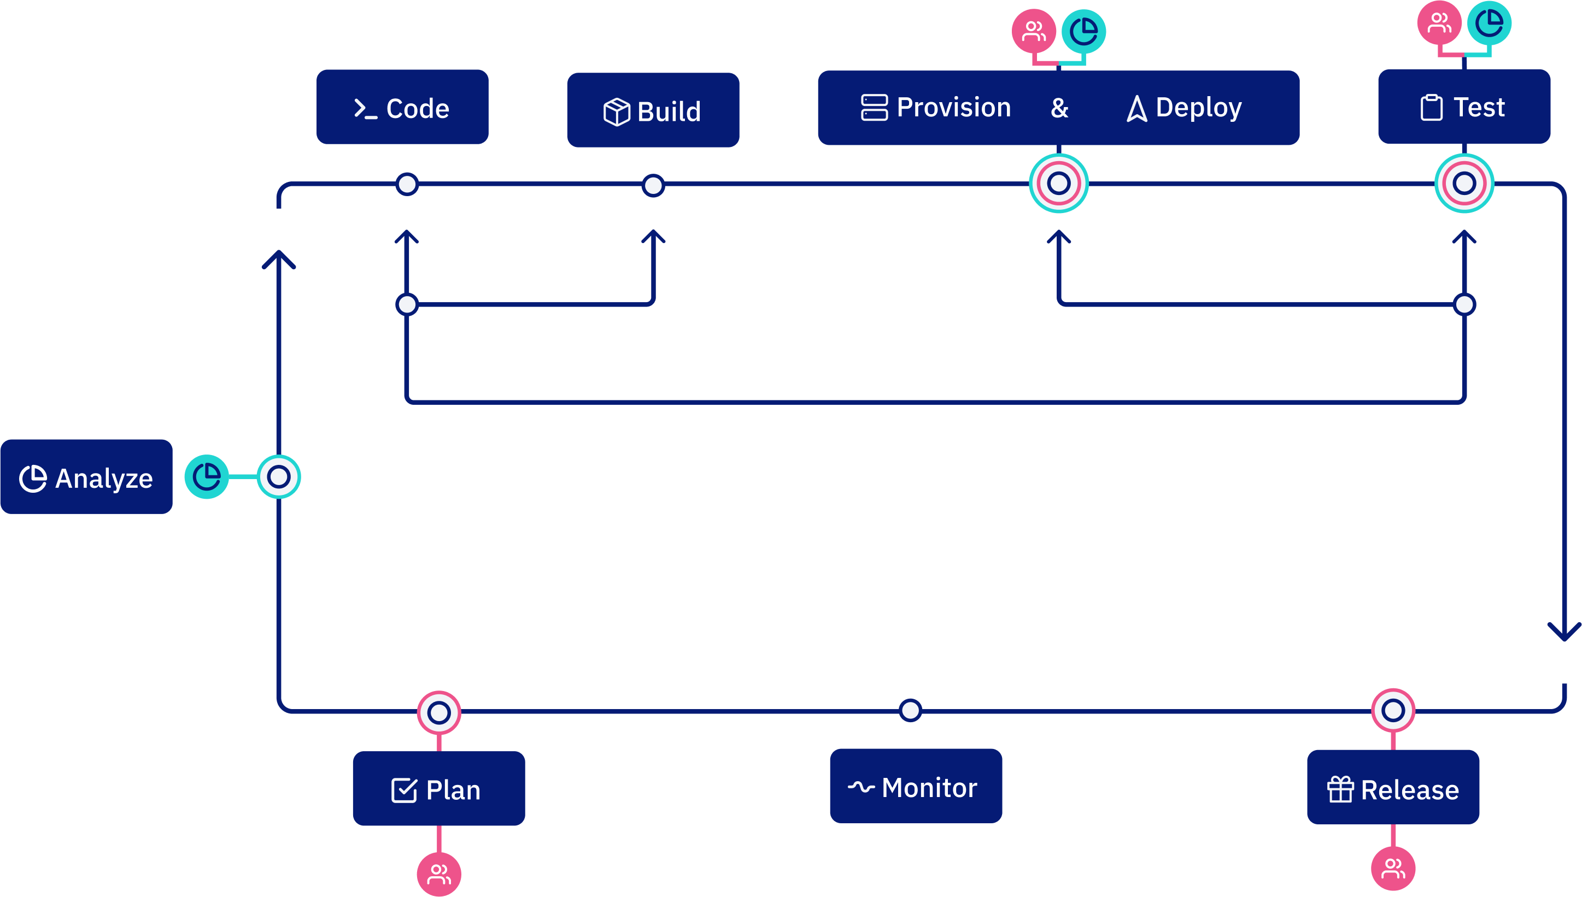






End to End Strategy
An End to End strategy is necessary to set steps to be taken
A single or similar DevOps pipeline improves collaboration and reduces friction between teams
Removing the differences that provide no value from z/OS to allow it to be part of any pipeline
Automated Testing at all levels
Workitems/Planning
Parallel Development
Test Environment Provisioning
Pipeline Automation
Development
SCM
Build
Artifact
Repository
Test Environments
Prod Environment
IDE, Impact Analysis Code Review, Unit Tests
Build, Code Quality
Test Automation, Code Coverage
Deployments

Slide 10


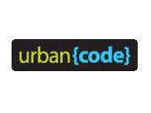

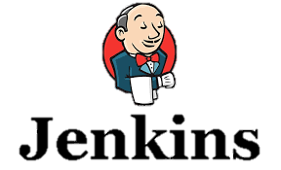
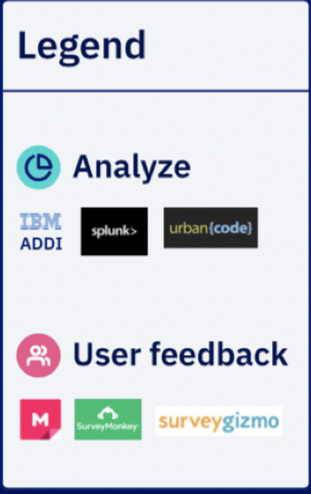
The pipeline - Integrated with Open Source
Notes:
What we want to do is provide this pipeline as the automation framework for the DevOps transformation
Everyone is a developer

Slide 11
A cross-platform, Enterprise tool stack
Mainframe
Distributed
Pipeline Coordination
Jenkins
Leverage existing cross-platform tools
Build on your current pipeline
Cross-train developers on familiar tooling
Requirements/Tasks
Issues or Jira
Analysis
ADDI
Source Control
Git
Development
ZOD, Eclipse (including IDz) , Visual Studio, …
Testing
Multiple, JUnit, ZUnit
Quality Control
SonarQube
Build
Maven, Gradle, Make, DBB
Artifact Repo
Artifactory or Nexus
Deployment Mgmt
Jenkins or UCD or Ansible
Release Mgmt
UCR
Notes:
Speaker: Phil

Slide 12
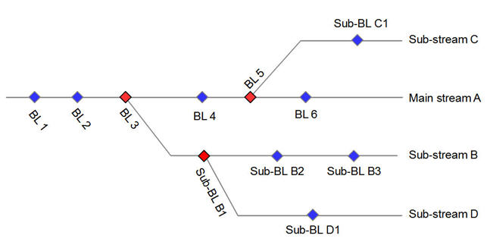
What does SCM stand for ?
Software Configuration Management is the task of tracking and controlling changes in the software
Configuration identification - Identifying configurations, configuration items and baselines.
Configuration control - Implementing a controlled change process.
Configuration auditing.
Source Control Management is a subfield of Configuration Management
Graph structure (line of development, branches).
Atomic operation, version merging, baselines, labels tags

Slide 13
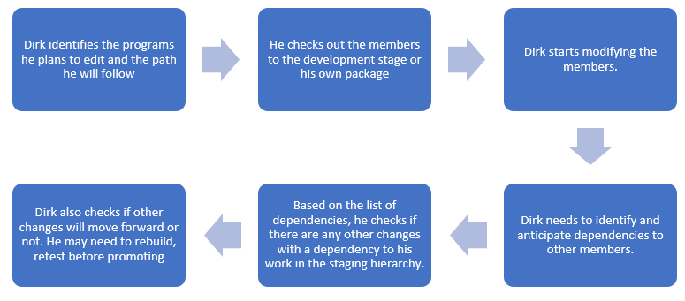
Library Managers
Relies on the concept of concatenation & promotion
Strong connection to execution environment
Limited for parallel development

Slide 14
Full configuration??? (nl)
“A configuration is made up of a given list of files, each of them at a given version. A configuration can have various scopes: for example, an application component, an application, a domain, or more.”
Release 11
Maint.
Release 12
Feature Branch
Feature Branch

Slide 15
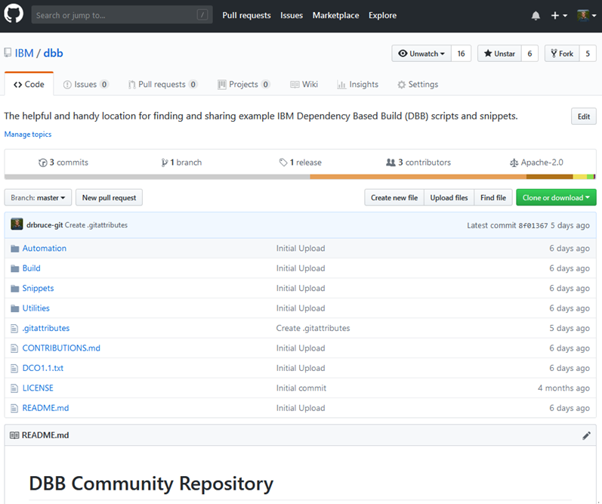
What is Git?
Open Source SCM initially built to manage Linux development
Distributed Source Code Management
Each developer works in their own local Git repository on their machine.
In most large companies today, there is a centralized instance of Git that is considered the server
Uses a commit ID instead of a version
SHA-1 hash based on the code, what came before it, who made the commit, when they made it, and other metadata
Used with other open source tools such as Jenkins, Ant, Maven, Gradle for Continuous Integration / Continuous Delivery pipeline
Strengths
Simple, cheap and easy to deploy
Pervasive in Open Source development where there is no effective competition
GitHub, GitLab, and BitBucket are common Git based web hosted repositories.

Slide 16
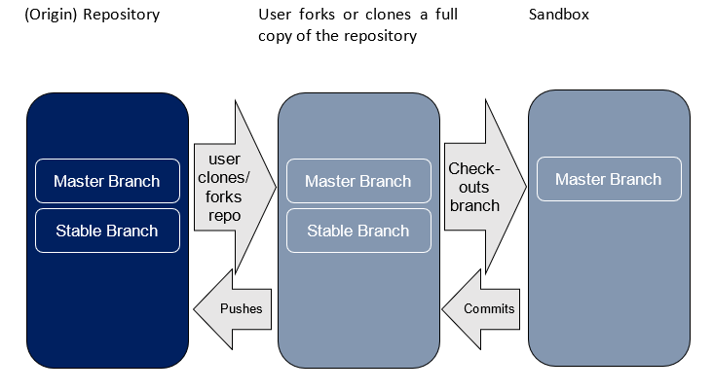
Git in a nutshell

Slide 17
Working in releases
Production
Test
Acceptance
Development
Master
Release
Feature 1
Feature 2
Fix 1
Feature 3
Integration
Maintenance
vs

Slide 18
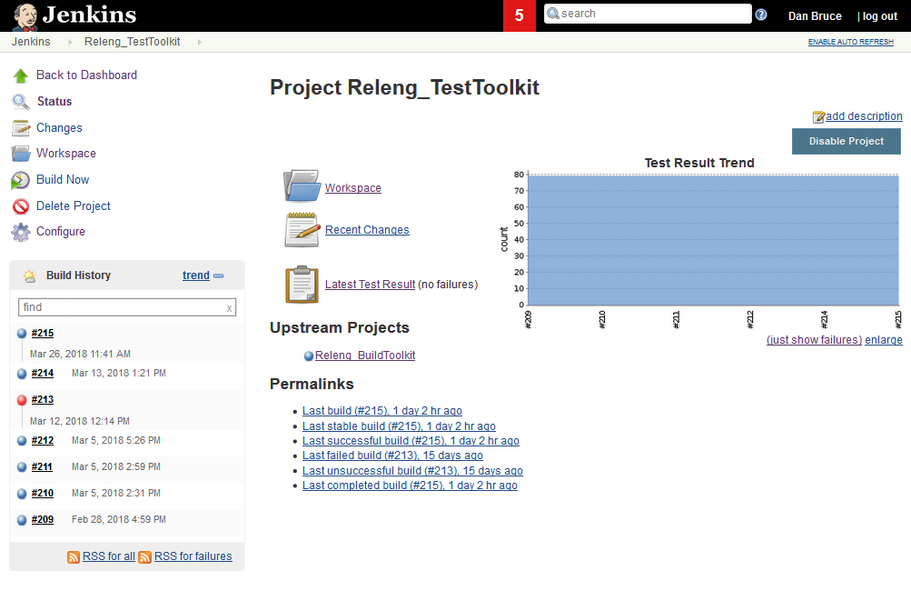
What is Jenkins?
An open source continuous integration (CI) server
Continuous Integration (CI) is the process of automating the build and testing of code every time a team member commits changes to version control.
Easily configurable.
Jenkins can be easily modified and extended. It deploys code instantly, generates test reports.
Jenkins can be configured according to the requirements for continuous integrations and continuous delivery.
Platform Independent.
Jenkins is available for all platforms and different operating systems, whether OS X, Windows or Linux.
Rich Plugin ecosystem.
The extensive pool of plugins makes Jenkins flexible and allows building, deploying and automating across various platforms.
Simple, cheap and easy to deploy
Pervasive in Open Source development where there is no effective competition

Slide 19
What is Groovy?
Groovy is a powerful, optionally typed and dynamic language, with static-typing and static compilation capabilities, for the Java platform
It integrates smoothly with any Java program, and immediately delivers to your application powerful features, including scripting capabilities
Concise, readable and expressive syntax, easy to learn for Java developers
Seamlessly and transparently integrates and interoperates with Java and any third-party libraries
Jenkins uses Groovy for its native scripting support

Slide 20
JCL vs Groovy+DBB APIs
import com.ibm.dbb.build.*
println("Copying source from zFS to PDS . . .")
def copy = new CopyToPDS().file(new File("/u/usr1/build/helloworld.cbl"))
.dataset("USR1.BUILD.COBOL").member("HELLO")
copy.execute()
println("Compiling . . .")
def tempOps = “tracks space(5,5) unit(vio) blksize(80) lrecl(80) recfm(f,b) new"
def compile = new MVSExec().pgm("IGYCRCTL").parm("LIB")
compile.dd(new DDStatement().name("TASKLIB").dsn("IGY.SIGYCOMP").options("shr"))
compile.dd(new DDStatement().name("SYSIN").dsn("USR1.BUILD.COBOL(HELLO)")
.options("shr"))
compile.dd(new DDStatement().name("SYSLIN").dsn("USR1.BUILD.OBJ(HELLO)")
.options("shr"))
compile.dd(new DDStatement().name("SYSPRINT").options(tempOps))
compile.dd(new DDStatement().name("SYSUT1").options(tempOps))
compile.dd(new DDStatement().name("SYSUT2").options(tempOps))
compile.dd(new DDStatement().name("SYSUT3").options(tempOps))
compile.dd(new DDStatement().name("SYSUT4").options(tempOps))
compile.dd(new DDStatement().name("SYSUT5").options(tempOps))
compile.dd(new DDStatement().name("SYSUT6").options(tempOps))
compile.dd(new DDStatement().name("SYSUT7").options(tempOps))
compile.copy(new CopyToHFS().ddName("SYSPRINT")
.file(new File("/u/usr1/build/helloworld.log")))
def rc = compile.execute()
if (rc > 4)
println("Compile failed! RC=$rc")
else
println("Compile successful! RC=$rc")
//COBOL EXEC PGM=IGYCRCTL,REGION=0M,
// PARM='LIB'
//*
//STEPLIB DD DISP=SHR,DSN=IGY.SIGYCOMP
//*
//SYSIN DD DISP=SHR,DSN=USER1.BUILD.COBOL(HELLO)
//SYSLIN DD DISP=SHR,DSN=USER1.BUILD.OBJ(HELLO)
//SYSPRINT DD SYSOUT=*
//SYSUT1 DD DISP=(NEW,PASS),SPACE=(TRK,(5,5)),UNIT=VIO,
// BLKSIZE=80,LRECL=80,RECFM=FB
//SYSUT2 DD DISP=(NEW,PASS),SPACE=(TRK,(5,5)),UNIT=VIO,
// BLKSIZE=80,LRECL=80,RECFM=FB
//SYSUT3 DD DISP=(NEW,PASS),SPACE=(TRK,(5,5)),UNIT=VIO,
// BLKSIZE=80,LRECL=80,RECFM=FB
//SYSUT4 DD DISP=(NEW,PASS),SPACE=(TRK,(5,5)),UNIT=VIO,
// BLKSIZE=80,LRECL=80,RECFM=FB
//SYSUT5 DD DISP=(NEW,PASS),SPACE=(TRK,(5,5)),UNIT=VIO,
// BLKSIZE=80,LRECL=80,RECFM=FB
//SYSUT6 DD DISP=(NEW,PASS),SPACE=(TRK,(5,5)),UNIT=VIO,
// BLKSIZE=80,LRECL=80,RECFM=FB
//SYSUT7 DD DISP=(NEW,PASS),SPACE=(TRK,(5,5)),UNIT=VIO,
// BLKSIZE=80,LRECL=80,RECFM=FB

Slide 21
What is Dependency Based Build?
IBM Dependency Based Build (DBB) is a tool to build traditional z/OS applications such as COBOL and PL/I as part of a continuous integration (CI) pipeline.
Provides a modern scripting language based automation capability that can be used on z/OS.
The DBB API is written in Java and can be called by Java applications as well as Java based scripting languages such as Groovy, JRuby, Jython, Ant, Maven, etc.
Not tied to a specific source code manager or pipeline automation tool.
Consists of a build toolkit (Java API, Groovy Installation, utility shell scripts) installed on USS and a Liberty application server that hosts build metadata (dependency data, build results)

Slide 22





DBB Architecture
IBM Dependency Based Build (DBB) - Intelligent build environment for applications stored in Git
Groovy driven build environment for compiling, linking and processing z/OS programs and applications
Dependency identification and understanding
Automatically identify program dependencies , build intelligently based on dependencies
Integration with any CI tooling
Provides User Build integration with ZOD / IBM Developer for System z
Git server
DBB Liberty App
Dependency Data
Build Results
Branch release 2
Branch release 1
DBB Toolkit
Agent
Status, logs and links to reports
USS
PDS
Build scripts
(scan, impact analysis, copy to PDS, compile, link-edit, bind, report)

Slide 23
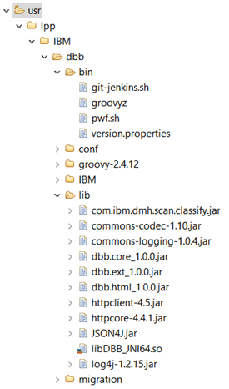
Components
Toolkit
The toolkit provides a set of Java APIs that can be used to define an intelligent build script. The APIs include capability such as:
Invoke MVS programs
Run TSO/ISPF commands
Submit JCL jobs
Scan, store and retrieve dependency information
Utility capabilities such as creating and copying to/from PDS
zImport capability for migration to git
Ability to create and store summary build reports
Java API for accessing Web Application
Installed via SMP/E
The DBB toolkit is packaged as part of the following products:
IBM Application Delivery Foundation for z Systems
IBM Developer for z Systems Enterprise Edition
IBM Z Open Development – Available December 2018

Slide 24
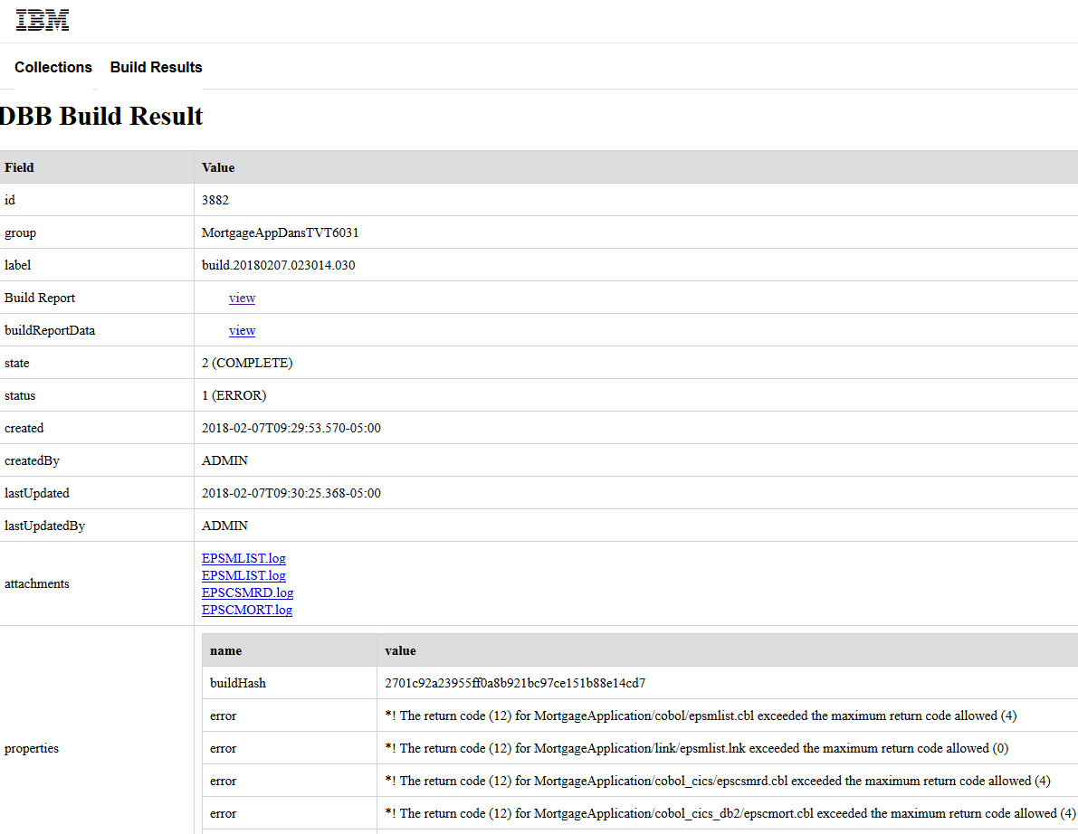
Components
Web Application
The web application is used to store and retrieve the dependency information and to store build reports. The web application is to be used by provided REST APIs and the toolkit APIs to create the intelligent build scripts.
Samples
The samples provide a set of Groovy scripts along with example programs to demonstrate how intelligent build scripts can be created. The samples are built such that they can be used as a starting point for a build process. The samples are also available at the public DBB community repository at https://git.com.ibm.dbb.

Slide 25
Invoking a DBB build
DBB is a Java API and can be invoked in many different ways
Java, Ant, Maven, Gradle, Jruby, Scala, etc.
Users will probably use Groovy as the DBB scripting language
DBB ships with an Apache Groovy installation modified to run on USS
DBB shipped samples and documentation examples all use Groovy
DBB documents three ways to invoke Groovy
Command Line
Jenkins Groovy Plugin
IDz User Build

Slide 26
Command Line
To run a Groovy script containing DBB APIs using the Groovy installation command directly, you will need to add both class path and library path parameters pointing to the DBB toolkit lib directory. Assuming that the DBB toolkit is installed at /usr/lpp/IBM/dbb, the command to run the helloworld.groovy build script will look like the following.
/usr/lpp/IBM/dbb/groovy-2.4.12/bin/groovy -cp "/usr/lpp/IBM/dbb/lib/*"
-Djava.library.path=/usr/lpp/IBM/dbb/lib helloworld.groovy
Alternatively the DBB toolkit provides a shell script in its bin directory called groovyz that can also be used to invoke Groovy scripts containing DBB APIs. Its utility is that it automatically adds the required DBB class path and library path parameters to the Groovy invocation thus simplifying the command:
/usr/lpp/IBM/dbb/bin/groovyz helloworld.groovy

Slide 27
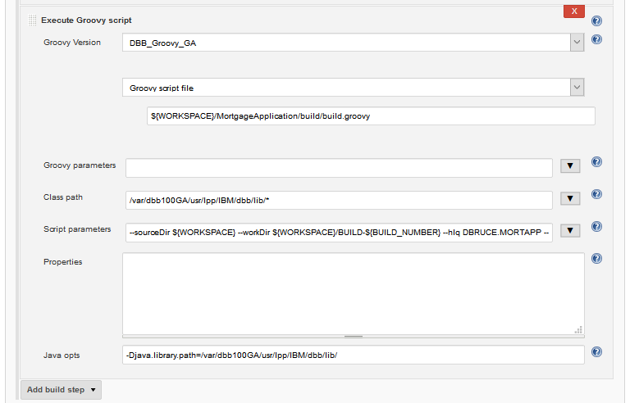
Jenkins Groovy Plugin
Jenkins provides a Groovy build step plugin
Instructions in the KC show how to define a “Groovy Version” that points to the DBB Apache Groovy installation
IMPORTANT!!
Class path must include DBB lib jar files
Java opts must include java.library.path with DBB lib path where the DBB JNI_64 DLL resides

Slide 28
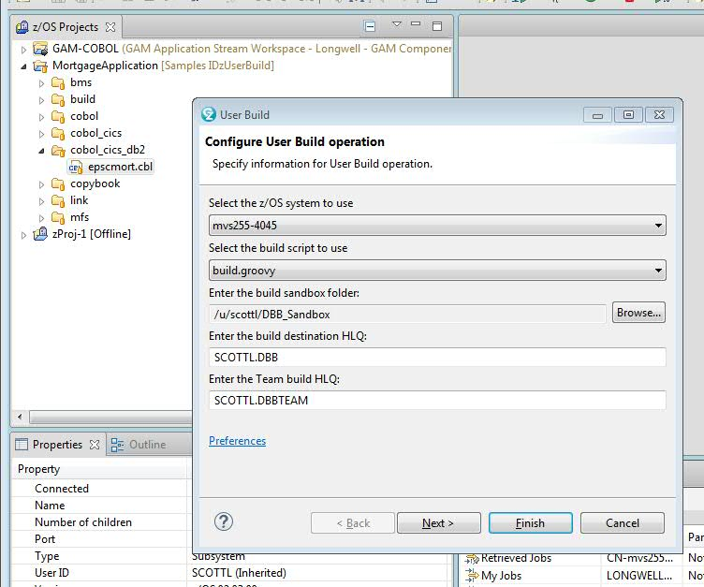
IDz User Build
IDz has provided User Build support for DBB
Currently works with EGit plugins and Git for z/OS
Sample COBOL application provided with DBB
Sample Groovy build scripts provided with DBB

Slide 29
Migration

Slide 30





Migration process and tools
Analysis Tools
Questionnaire
Extraction Tools
BP/Client Tools
Scanner Tools
Application discovery (ADDI)
Migration Tools
SCLM Mig Toolkit
Import Tool
JCL Mig Tool
CI/CD
CI/CD Pipeline
Analyse
Extract
Componentize
CI/CD
Migrate
Analysis
Analyse the development process, Infrastructure and document the current state
Extract Metadata, Source Libraries, Compile Procedures and options, Languages, File types from Host SCM
Identify Interfaces and dependencies between applications and componentize
Derive future state architecture
Establish CI/CD workflow
Product deployment
Setup repos and Import
Setup the scripts and establish the pipeline

Slide 31
Breaking down the monolith - Interactions of applications
Application 1
Application 1 separates into public interfaces and its implementation
Application 2 follows the same mimic, but also uses services from App1 and App3. Therefore the configuration requires at least the interface description to be buildable
Public Interface of Application 1
Private Implementation of Application 1
Application 2
Application 3
Public Interface of Application 2
Public Interface of Application 3
Private Implementation of Application 2
Private Implementation of Application 3
Interface of Application 1
Interface of Application 3
Interface of Application 1

Slide 32
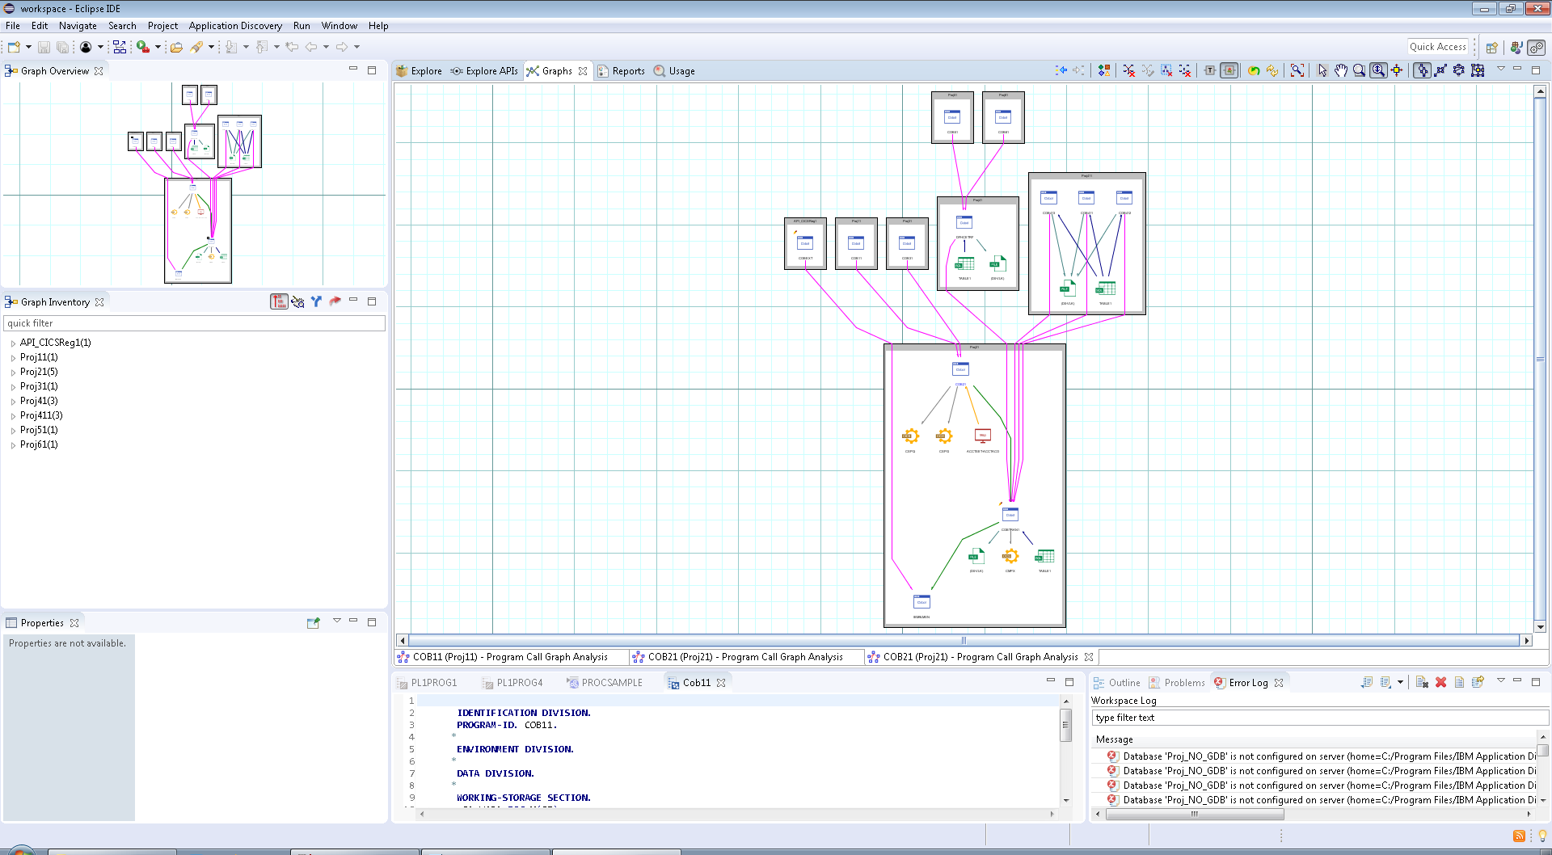
Cross Application graph showing interface calls between applications
AD for Componentization

Slide 33
Migration Tools
SCLM Migration Toolkit
https://github.com/IBM/dbb/tree/master/Migration/sclm
The SCLM migration is a set of scripts used to extract SCLM information and place it in Git repository
Migration is performed in three phases
1.Extract SCLM metadata
2.Migrate source members
3.Create Groovy build scripts
zImport Tool
https://www.ibm.com/support/knowledgecenter/SS6T76_1.0.3/migration.html
You can use the migration tool to copy source files from data set libraries to the local repository. In addition to copying the source from PDS to zFS, the migration tool will also create and update the .gitattributes file required by Rocket's Git client to perform automatic codepage conversion between the Git server and the local Git repository during the migration.
JCL Migration Tool
Open source - Scheduled to be made available in public Github before 2nd Qtr 2019.

Slide 34
Simplify your Journey towards DevOps transformation through DevOps Acceleration Program(DAP)
DAP provides with expert advice on the best transformation approach for your enterprise, from any model to DevOps.
It includes how-to guides on culture, best practices, tools, training, and even sample code and architectures
Product Deployment
Deployment preparation
Rollout planning – Workflow and Use Case analysis
Assistance on Installation, Configuration, Optimization
Best Practices – in the areas of production Adoption
SCM Migration
Assessment of current state client setup
Transformation/Product workshop and Future state High level architecture
Representative Migration
Migration approach for future implementation
Knowledge transfer
For further details about the program, please contact
mfdevopsaccelerator@ibm.com , jayakarm@ibm.com

Slide 35
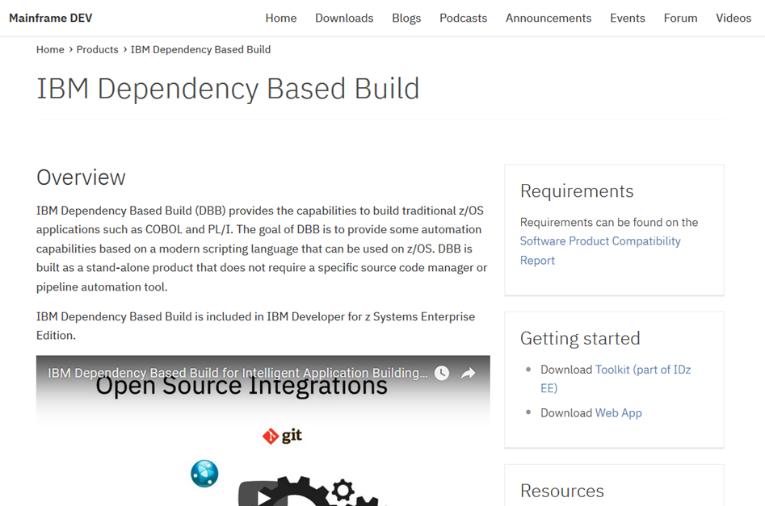
DBB is on Mainframe DEV
https://developer.ibm.com/mainframe/products/ibm-dependency-based-build/
Contains link to the DBB Toolkit download on Shopz
Contains link to the DBB Web App + Samples on the Mainframe Dev website

Slide 36
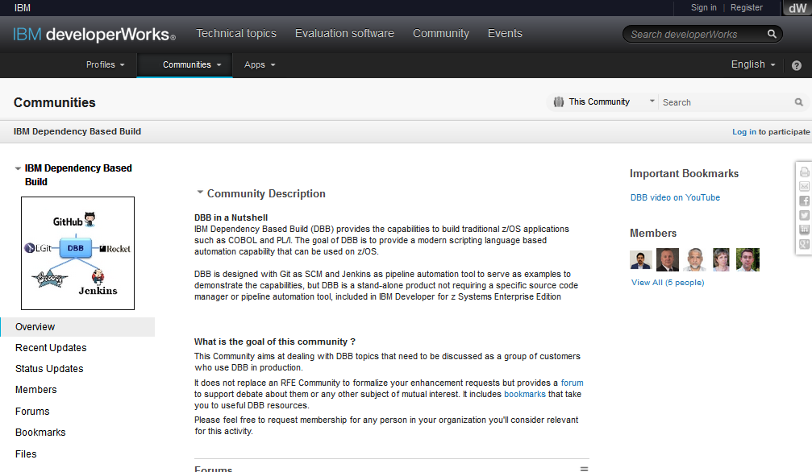
DBB is on developerWorks
http://ibm.biz/dbb_community

Slide 37
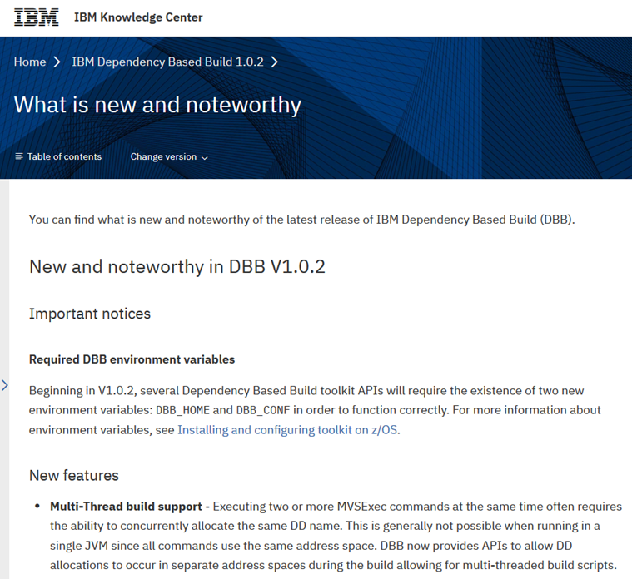
DBB Knowledge Center
https://www.ibm.com/support/knowledgecenter/SS6T76_1.0.2/welcome.html
Contains installation instructions
Includes product prerequisites
Includes a copy of the program directory
There is a section on writing build scripts
Includes a HelloWorld tutorial
Details on the z/OS Command APIs available
Examples of how to scan and store dependencies
API reference includes
REST API for the Web App
Javadoc for the Toolkit API

Slide 38
DBB Community on the public GitHub
https://github.com/ibm/dbb
Samples demonstrating using DBB APIs:
- Hello World First Script
Example Hello world program and build script created with hard coded values to show the simplest form of using DBB to build z/OS programs.
- Mortgage Application
Example application in COBOL as well as the build scripts to build it. This is the most complex of the samples, it includes integration with Urban Code Deploy for deployment, as well as externally customizable settings for build related properties.
- Extend Build Report
A sample showing how to extend Build Report to display Git hash value for each file.
Process for contributing additional build scripts and automation tasks using DBB APIs.

Slide 39
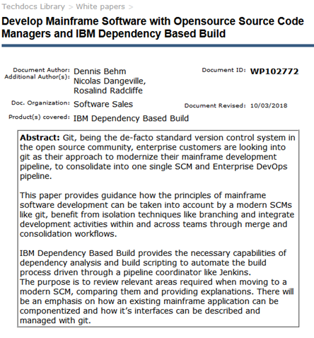
Git Migration White Paper
http://www-03.ibm.com/support/techdocs/atsmastr.nsf/WebIndex/WP102772
Moving from a legacy z/OS Library Manager to Git is not just about tools.
There are some key differences between traditional and modern SCM approaches.
This whitepaper is a synthesis of expert guidance learned in collaboration with mainframe development organizations.
Explains how to adopt and manage the transition at a process level.
Hash a special focus on how an existing mainframe application can be componentized and how the application interfaces can be described and managed, as well as built.

Slide 40
THANK YOU

Slide 41
BACKUP

Slide 42
Use Cases
Main Use Cases
DBB – can be stand alone – works without other products to provide automation and build capability
DBB - as part of DevOps pipeline
Git/DBB/Jenkins/UCD as an example, other CI/CD automation tools can be used as long as they can run tasks on z/OS
Alternative Use Cases
Automation tool – use groovy for any task
Run any MVS.TSO, ISPF command
Interact with zFS or PDS/PDSEs
Share automation with other systems
Since groovy is used for automation on other platforms, the same automation code could be used on z/OS as for for example integration with other open source tools, kicking off of testing, quality scanning

Slide 43
Build Script Customization
Property File Support
Property files can be used to customize build scripts
Are stored in the SCM along side build scripts
Java/Groovy has native property file support with the java.util.Properties class
DBB provides the BuildProperties class
There is a single static BuildProperties instance that is available at all times in all code
Introduces file properties that associate specific properties to a set of files or even a single file via file path patterns:
compileOpts = LIB
compileOpts = APOST,DATA31,LIB,DYNAM :: App1/OldCobol/*.cbl
def parm = BuildProperties.getFileProperty("compileOpts", file)
Sandbox Properties
sourceDir – the location of the local git repository
workDir – the location of the build work directory
hlq – the high level qualifier of the PDSs used for build input and output datasets
Script Parameters
Can be passed in from Jenkins
Can be used to override property file values

Slide 44
Build Script Organization
Main Build Script
This is the script that is called at the beginning of the build process
A good place to perform build initialization and completion tasks
Build List
The list of programs to build/process
Usually contained in a text file
Can be a static file or generated by a previous build step or external process
Called Build Scripts
Designed to build one type of program
Can use conditional logic to add/omit DD allocations or even MVSExec commands altogether
Has access to the BuildProperties instance
Main script can pass an array of String arguments to the called script
Script Mappings
Special file property used to associate build scripts to a set of programs
DBB provides the ScriptMappings utility class to simplify using script mapping file properties

Slide 45
ScriptMapping Example
# Script Mappings - used to associate build scripts to programs
scriptMapping = BMSProcessing :: MortgageApplication/bms/*.bms
scriptMapping = Compile :: MortgageApplication/cobol/epsmlist.cbl, MortgageApplication/cobol/epsnbrvl.cbl
scriptMapping = CobolCompile :: MortgageApplication/cobol/epsmpmt.cbl, MortgageApplication/cobol_cics/*.cbl, \
MortgageApplication/cobol_cics_db2/*.cbl
scriptMapping = LinkEdit :: MortgageApplication/link/*.lnk
scriptMapping = MFSGENUtility :: MortgageApplication/mfs/*.mfs
// build programs by invoking the appropriate build script
def buildOrder = ["BMSProcessing", "Compile", "LinkEdit", "CobolCompile"]
// optionally execute IMS MFS builds
if (properties.BUILD_MFS.toBoolean())
buildOrder << "MFSGENUtility"
println("** Invoking build scripts according to build order: ${buildOrder[1..-1].join(', ')}")
buildOrder.each { script ->
// Use the ScriptMappings class to get the files mapped to the build script
def buildFiles = ScriptMappings.getMappedList(script, buildList)
def scriptName = "$properties.sourceDir/MortgageApplication/build/${script}.groovy"
buildFiles.each { file ->
run(new File(scriptName), [file] as String[])
processCounter++
}
}

Slide 46
zOS Command APIs
MVSExec
Used to invoke zOS programs like pre-compilers, compilers and link-editors.
Designed to look (somewhat) like a JCL job step
MVSJob
Used to demark the scope of a set of MVSExec commands that pass temporary DD allocations so that they can be freed at the end of the job.
ISPFExec
Used to invoke ISPF commands
TSOExec
Used to invoke TSO commands
JCLExec
Used to submit JCL jobs
CreatePDS
Used to create new datasets required by the build
Will only create a new dataset if one does not exist.
CopyToPDS
Used to copy source files from zFS to PDS for compilation
CopyToHFS
Used to copy PDS members to zFS
Useful for capturing SYSPRINT data as build logs

Slide 47
Dependency Identification
Dependency Scanner
DBB toolkit includes the RAA Classification scanner
The RAA scanner supports Assembler, C/C++, Cobol, PL/I
DBB provides the IDependencyScanner interface allowing customers to write their own scanners
Logical File
The dependency data collected by the dependency scanner
Contains the scanned file name, logical name, language, and logical dependencies.
Also contains flags indicating the source file has CICS, SQL, or DLI statements
Collection
Logical files can be stored in “collections” in the DBB Web App database
Collections can have any name but it is recommended to use the name of the Git branch the source files being scanned belong to
Logical files in a collection use the scanned file name (usually the relative path from the sourceDir) as a unique identifier in the database
Repository Client
All data in the DBB Web App is accessible via REST API
The DBB Toolkit provides the RepositoryClient utility class that contains common repository accessor methods

Slide 48
Dependency Resolution
Dependency Resolver
The DependencyResolver class is used to resolve the logical dependencies in a programs logical file to physical files in the local Git repository
This is needed so that the latest version of required copybooks can be copied from zFS to PDS along with the program to be built
The dependency resolver resolves the dependencies of one program at a time
Resolution Rule
The dependency resolver uses one or more resolution rules to locate the logical dependency in the local Git repository
A rule consists of a matching criteria i.e. three optional fields (lname, library, category) and a search path
A logical dependency “matches” a rule if it matches the rule’s criteria
If a match, then the search path is searched to locate the file
Dependency Path
The search path is a list of DependencyPath objects
Each DependencyPath contains the collection and directory to search
Physical Dependency
When a resolution rule matches a logical dependency then an unresolved physical dependency is created
If the logical dependency is located in the search path, then the physical dependency is resolved and can be used the CopyToPDS command to copy the dependency file from zFS to PDS

Slide 49
Build Report
Collects build report data records generated by certain commands and/or actions that occur during the build
The CopyToPDS, CopyToHFS, MVSExec, TSOExec, and ISPFExec commands contribute data records
The build report is extensible so that customers can provide custom build classes that contribute to the build report
A “Basic” build report record will be available to allow customers to create and contribute records to the build report any time they want in a build script
The build report is saved as two files: a JSON data file and an HTML display file
The HTML file is “rendered” from the data in the JSON file by using a combination of files:
An HTML template
A CSS File
A JavaScript rendering file
The DBB toolkit provides default files for all three rendering files
Users can provide their own rendering files
A example showing how to extend the build report with additional records and how to provide rendering files to display the additional information will be provided in the samples.

Slide 50
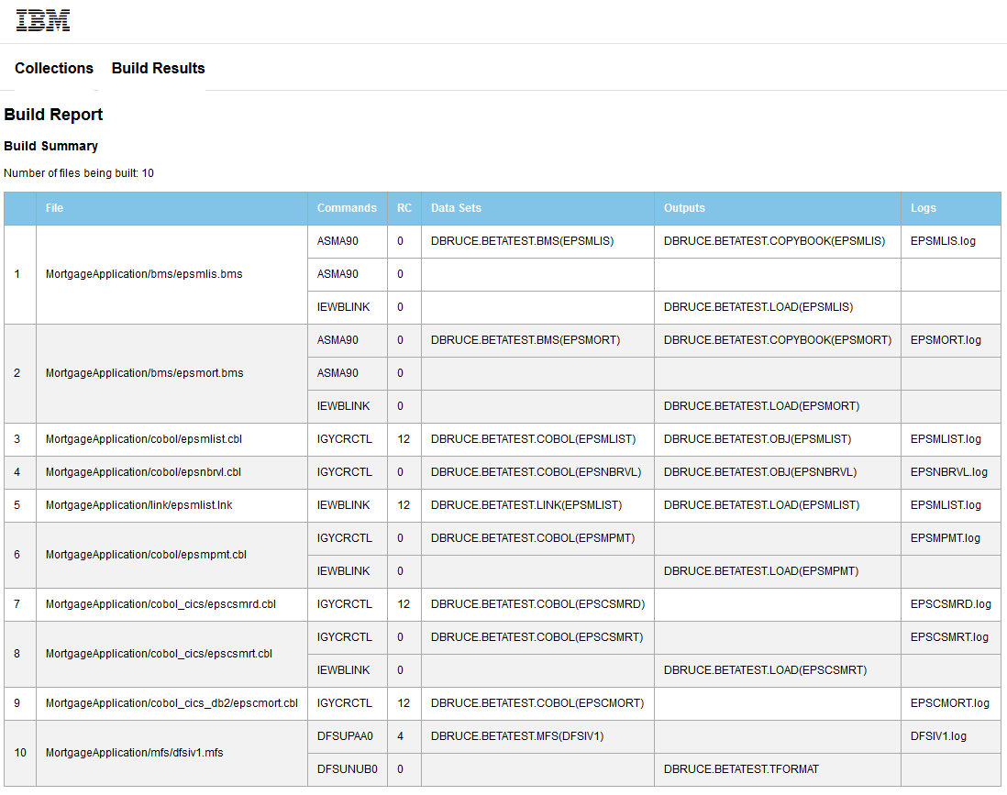
Build Report

Slide 51
Build Result
The build result allows the user to collect build metadata during the build and store it in the DBB Web App database
Users can store the following information in the build results:
The current build state: NEW, PROCESSING, COMPLETE, ABANDONED
The current built status: CLEAN, ERROR, WARNING
The build report html and json files
Additional file attachments such as log files
Simple information in the form of properties
When creating a build report the user provides a “group” and “label” value.
The group is used to provide the build group id
The label is used to provide a unique name for the specific build result
The DBB repository client provides utility methods to retrieve and search for specific build results
getBuildResult(id)
getBuildResult(group, label)
getAllBuildResults(group)
getLastBuildResult(group, state, status)

Slide 52
Build Result

Slide 53
DBB API Examples

Slide 54
CreatePDS command
Used to create a new PDS. Will skip creation if PDS already exists
// Standard Java API
CreatePDS createPDS = new CreatePDS();
createPDS.setDataset("USR1.BUILD.COBOL");
createPDS.setOptions("cyl space(1,1) lrecl(80) dsorg(PO) recfm(F,B)");
createPDS.execute();
// Supports setter method chaining
def createPDS = new CreatePDS().dataset("USR1.BUILD.COBOL").options("cyl space(1,1) lrecl(80) dsorg(PO) recfm(F,B)")
createPDS.execute()
// or even
new CreatePDS().dataset("USR1.BUILD.COBOL").options("cyl space(1,1) lrecl(80) dsorg(PO) recfm(F,B)").execute()
// Create datasets needed for the build
def properties = BuildProperties.getInstance()
def srcOptions = "cyl space(1,1) lrecl(80) dsorg(PO) recfm(F,B) dsntype(library) msg(1)"
def loadOptions = "cyl space(1,1) dsorg(PO) recfm(U) blksize(32760) dsntype(library) msg(1)"
def srcDatasets = ["COBOL", "COPYBOOK", "OBJ", "BMS", "DBRM", "LINK", "MFS"]
def loadDatasets = ["LOAD", "TFORMAT"]
srcDatasets.each { dataset ->
new CreatePDS().dataset("${properties.hlq}.$dataset").options(srcOptions).create()
}
loadDatasets.each { dataset ->
new CreatePDS().dataset("${properties.hlq}.$dataset").options(loadOptions).create()
}
if (properties.errPrefix) {
def xmlOptions = "tracks space(200,40) dsorg(PS) blksize(27998) lrecl(16383) recfm(v,b) new"
new CreatePDS().dataset("${properties.hlq}.${properties.errPrefix}.SYSXMLSD.XML").options(xmlOptions).create()
}

Slide 55
CopyToPDS command
Used to copy a zFS file to a PDS.
// Standard Java API
File file = new File("/u/usr1/build/helloworld.cbl");
CopyToPDS copy = new CopyToPDS();
copy.setFile(file);
copy.setDataset("USR1.BUILD.COBOL");
copy.setMember("HELLO");
copy.execute();
// Supports setter method chaining
def copy = new CopyToPDS().file(new File("/u/usr1/build/helloworld.cbl")).dataset("USR1.BUILD.COBOL").member("HELLO")
copy.execute()
// copy source from zFS to PDS
def cobolPDS = "${properties.hlq}.COBOL"
def copybookPDS = "${properties.hlq}.COPYBOOK"
def member = CopyToPDS.createMemberName(file)
println("Copying ${properties.sourceDir}/$file to $cobolPDS($member)")
new CopyToPDS().file(new File("${properties.sourceDir}/$file")).dataset(cobolPDS).member(member).execute()
println("Resolving dependencies for file $file and copying to $copybookPDS")
def resolver = tools.getDefaultDependencyResolver(file)
def deps = resolver.resolve()
new CopyToPDS().dependencies(deps).dataset(copybookPDS).execute()

Slide 56
MVSExec command
The MVSExec command is used to invoke a zOS program.
// Standard Java API
MVSExec compile = new MVSExec();
compile.setPgm("IGYCRCTL");
compile.setParm("LIB");
int rc = compile.execute()
// Supports setter method chaining
def compile = new MVSExec().pgm("IGYCRCTL").parm("LIB")
def rc = compile.execute()
// Creating DD Statements (Standard Java API)
DDStatement sysin = new DDStatement();
sysin.setName("SYSIN");
sysin.setDsn("USR1.BUILD.COBOL(HELLO)");
sysin.setOptions("shr");
compile.addDDStatement(sysin);
// Supports setter method chaining
compile.dd(new DDStatement().name("SYSIN").dsn("USR1.BUILD.COBOL(HELLO)").options("shr"))
// Define temporary datasets by omitting the dataset name (dsn)
compile.dd(new DDStatement().name("SYSUT1").options("cyl space(5,5) unit(vio) new"))
// Define DD concatenations by omitting the DD Statement name.
// The DD will be concatenated to the previously named DD Statement
compile.dd(new DDStatement().name("TASKLIB").dsn("IGY.V4R2M0.SIGYCOMP").options("shr"))
compile.dd(new DDStatement().dsn("DFH.V3R2M0.CICS.SDFHLOAD").options("shr"))
compile.dd(new DDStatement().dsn("DSN.V9R1M0.SDSNLOAD").options("shr"))

Slide 57
MVSExec command (continued)
** Note that “TASKLIB” replaces the JCL “STEPLIB”
// Compile a COBOL program
def tempOpts = "cyl space(5,5) unit(vio) new"
def compile = new MVSExec().pgm("IGYCRCTL").parm("LIB")
compile.dd(new DDStatement().name("SYSIN").dsn("USR1.BUILD.COBOL(HELLO)").options("shr"))
compile.dd(new DDStatement().name("SYSLIN").dsn("USR1.BUILD.OBJ(HELLO)").options("shr"))
compile.dd(new DDStatement().name("SYSUT1").options(tempOpts))
compile.dd(new DDStatement().name("SYSUT2").options(tempOpts))
compile.dd(new DDStatement().name("SYSUT3").options(tempOpts))
compile.dd(new DDStatement().name("SYSUT4").options(tempOpts))
compile.dd(new DDStatement().name("SYSUT5").options(tempOpts))
compile.dd(new DDStatement().name("SYSUT6").options(tempOpts))
compile.dd(new DDStatement().name("SYSUT7").options(tempOpts))
compile.dd(new DDStatement().name("SYSUT8").options(tempOpts))
compile.dd(new DDStatement().name("SYSUT9").options(tempOpts))
compile.dd(new DDStatement().name("SYSUT10").options(tempOpts))
compile.dd(new DDStatement().name("SYSUT11").options(tempOpts))
compile.dd(new DDStatement().name("SYSUT12").options(tempOpts))
compile.dd(new DDStatement().name("SYSUT13").options(tempOpts))
compile.dd(new DDStatement().name("SYSUT14").options(tempOpts))
compile.dd(new DDStatement().name("SYSUT15").options(tempOpts))
compile.dd(new DDStatement().name("SYSUT16").options(tempOpts))
compile.dd(new DDStatement().name("SYSUT17").options(tempOpts))
compile.dd(new DDStatement().name("SYSMDECK").options(tempOpts))
compile.dd(new DDStatement().name("TASKLIB").dsn("IGY.V6R1M0.SIGYCOMP").options("shr"))
def rc = compile.execute()
if (rc > 4)
println("Compile failed! RC=$rc")
else
println("Compile successful! RC=$rc")

Slide 58
MVSJob
The purpose of MVSJob is to clean up passed temporary DD Statements.
* DD Statements are allocated at the beginning of the MVSExec command and freed automatically at the end
* DD Statements with temporary datasets can be passed to following MVSExec commands by adding .pass(true)
* The MVSJob is used to determine when to free passed temporary DD Statements
// Example of passing the SYSLIN from the compiler to the Link-Editor
def compile = new MVSExec().file(file).pgm("IGYCRCTL").parm(compileParms)
compile.dd(new DDStatement().name("SYSIN").dsn("$cobolPDS($member)").options("shr"))
compile.dd(new DDStatement().name("SYSLIN").dsn("&&TEMPOBJ").options(tempCreateOptions).pass(true))
compile.dd(new DDStatement().name("SYSPRINT").options(tempCreateOptions))
compile.dd(new DDStatement().name("SYSUT1").options(tempCreateOptions))
. . .
def linkedit = new MVSExec().file(file).pgm("IEWBLINK").parm("MAP,RENT,COMPAT(PM5)")
linkedit.dd(new DDStatement().name("SYSLMOD").dsn("$loadPDS($member)").options("shr"))
linkedit.dd(new DDStatement().name("SYSPRINT").options(tempCreateOptions))
linkedit.dd(new DDStatement().name("SYSUT1").options(tempCreateOptions))
linkedit.dd(new DDStatement().name("SYSLIB").dsn(objectPDS).options("shr"))
// Usage #1 : use start() and stop() to set the boundaries of the passed DD statements
def job = MVSJob()
job.start()
def rc = compile.execute()
if (rc <= 4) {
rc = linkedit.execute()
}
job.stop()
// Usage #2 : Add MVSExec commands to the MVSJob and then execute with a maxRC
def rc = new MVSJob().executable(compile).executable(linkedit).maxRC(8).execute()

Slide 59
Debugging & Tracing

Slide 60
Tracing and logging
DBB does not automatically create a build log though customers could design their build scripts to do so.
The Samples that are shipped with DBB all write messages to the console.
Jenkins will capture the console output and save it with the Jenkins build results.
When executed from the command line the user will have to either copy the output from a scrollable interface like PuTTY or redirect the output to a file
The DBB toolkit contains a log4j.properties file that will output additional trace statements to the console.
The file is located in /usr/lpp/IBM/dbb/conf but may be moved to a writable disk
All trace statements are commented out by default so the user will need to uncomment the packages they want to trace.
To turn tracing on the customer needs to add the Java option:
“-Dlog4j.configuration=file:/usr/lpp/IBM/dbb/conf/log4j.properties”

Slide 61
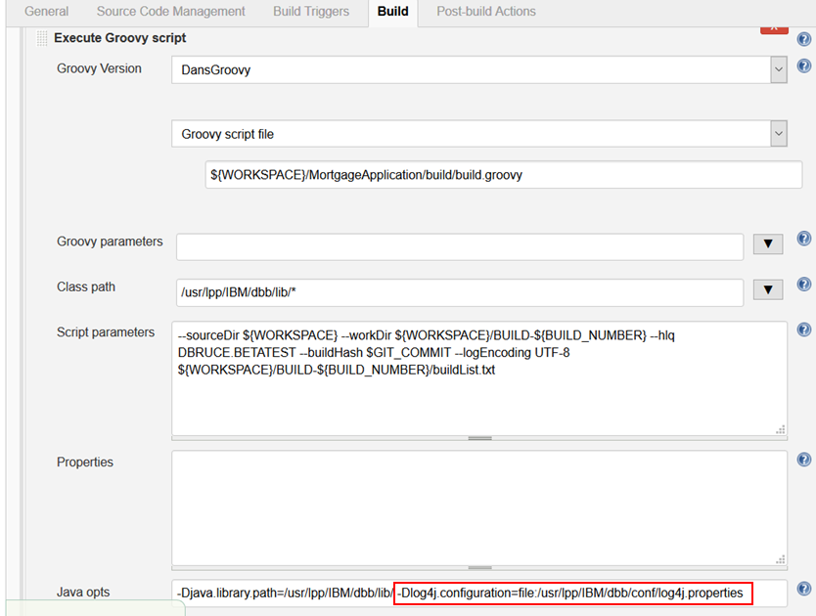
Turning on tracing
groovyz -Dlog4j.configuration=file:/usr/lpp/IBM/dbb/conf/log4j.properties build.groovy

Slide 62
/usr/lpp/IBM/dbb/conf/log4j.properties
# Default logging is for WARN and higher
log4j.rootLogger=WARN,stdout
# stdout Appender
log4j.appender.stdout=org.apache.log4j.ConsoleAppender
log4j.appender.stdout.layout=org.apache.log4j.PatternLayout
log4j.appender.stdout.layout.ConversionPattern=%p\t%d{ISO8601}\t%r\t%c\t[%t]\t%m%n
# Uncomment to enable tracing for build commands
#log4j.logger.com.ibm.dbb.build=DEBUG
#log4j.logger.com.ibm.dbb.build.internal=DEBUG
# Uncomment to enable tracing for dependency scanning and resolution
#log4j.logger.com.ibm.dbb.dependency=DEBUG
#log4j.logger.com.ibm.dbb.dependency.internal=DEBUG
# Uncomment to enable tracing for build report generation
#log4j.logger.com.ibm.dbb.build.report=DEBUG
#log4j.logger.com.ibm.dbb.build.report.records=DEBUG
# Uncomment to enable tracing for repository connection
#log4j.logger.com.ibm.dbb.repository=DEBUG
#log4j.logger.com.ibm.dbb.repository.internal=DEBUG

Slide 63
Debugging – Common Problems
// classpath is not set or does not include dbb lib folder
org.codehaus.groovy.control.MultipleCompilationErrorsException: startup failed:
/u/dbruce/test/jenkins/workspace/DansMortgageApp/MortgageApplication/build/impacts.groovy: 107: unable to resolve class DependencyScanner
@ line 107, column 15.
def scanner = new DependencyScanner()
^
// -Djava.library.path is not set or does not include dbb lib folder
Caught: java.lang.UnsatisfiedLinkError: DBB_JNI64 (Not found in java.library.path)
java.lang.UnsatisfiedLinkError: DBB_JNI64 (Not found in java.library.path)
at com.ibm.dbb.build.internal.jni.Executable.loadNativeLibrary(Executable.java:35)
at com.ibm.dbb.build.internal.jni.Executable.<clinit>(Executable.java:27)
at com.ibm.dbb.build.MVSExec.doExecute(MVSExec.java:91)
at com.ibm.dbb.build.AbstractExec.execute(AbstractExec.java:64)
at com.ibm.dbb.build.MVSJob.execute(MVSJob.java:83)
at com.ibm.dbb.build.MVSJob$execute$1.call(Unknown Source)
at BMSProcessing.run(BMSProcessing.groovy:84)
at build$_run_closure2$_closure3.doCall(build.groovy:117)
at build$_run_closure2.doCall(build.groovy:116)
at build.run(build.groovy:112)

Slide 64
Debugging – Common Problems
// ISPF editor is open with a file that DBB is trying to write to
Caught: com.ibm.dbb.build.BuildException: com.ibm.jzos.ZFileException: //'DBRUCE.MORTAPP.CLIST(BIND)': fopen() failed; EDC5061I An error occurred when attempting to define a file to the system.; errno=61 errno2=0xc00b0403 last_op=50 errorCode=0x210
com.ibm.dbb.build.BuildException: com.ibm.jzos.ZFileException: //'DBRUCE.MORTAPP.CLIST(BIND)': fopen() failed; EDC5061I An error occurred when attempting to define a file to the system.; errno=61 errno2=0xc00b0403 last_op=50 errorCode=0x210
at com.ibm.dbb.build.CopyToPDS.execute(CopyToPDS.java:75)
at com.ibm.dbb.build.IExecute$execute.call(Unknown Source)
at Bind.run(Bind.groovy:40)
at CobolCompile.run(CobolCompile.groovy:151)
at build$_run_closure2$_closure3.doCall(build.groovy:117)
at build$_run_closure2.doCall(build.groovy:116)
at build.run(build.groovy:112)

Slide 65
Debugging – Allocation Errors
Caught: com.ibm.team.dbb.build.BuildException: com.ibm.team.dbb.build.BuildException: An error occurred running bpxwdyn command 'alloc dd(TEMP0003) shr’
at com.ibm.team.dbb.build.MVSExec.doExecute(MVSExec.java:134)
at com.ibm.team.dbb.build.internal.AbstractExec.execute(AbstractExec.java:59)
at com.ibm.team.dbb.build.IExecute$execute.call(Unknown Source)
at CobolCompile.run(CobolCompile.groovy:138)
at build$_run_closure2$_closure3.doCall(build.groovy:113)
at build$_run_closure2.doCall(build.groovy:112)
at build.run(build.groovy:108)
Caused by: com.ibm.jzos.RcException: BPXWDYN failed; S99ERROR/S99INFO = 0x1708/0x2 RC=386400258 (0x17080002)
at com.ibm.jzos.ZFile.bpxwdyn(ZFile.java:152)
at com.ibm.team.dbb.build.internal.Utils.bpxwdyn(Utils.java:62)
Knowledge Center - Interpreting error reason codes from DYNALLOC
https://www.ibm.com/support/knowledgecenter/en/SSLTBW_2.1.0/com.ibm.zos.v2r1.ieaa800/erc.htm#erc__mjfig7

